Slide 1


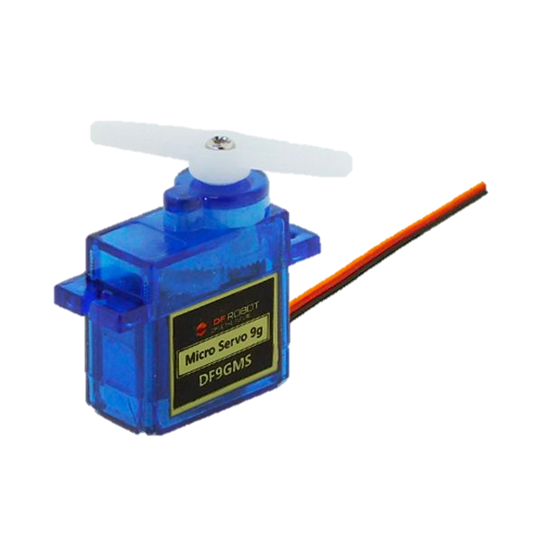
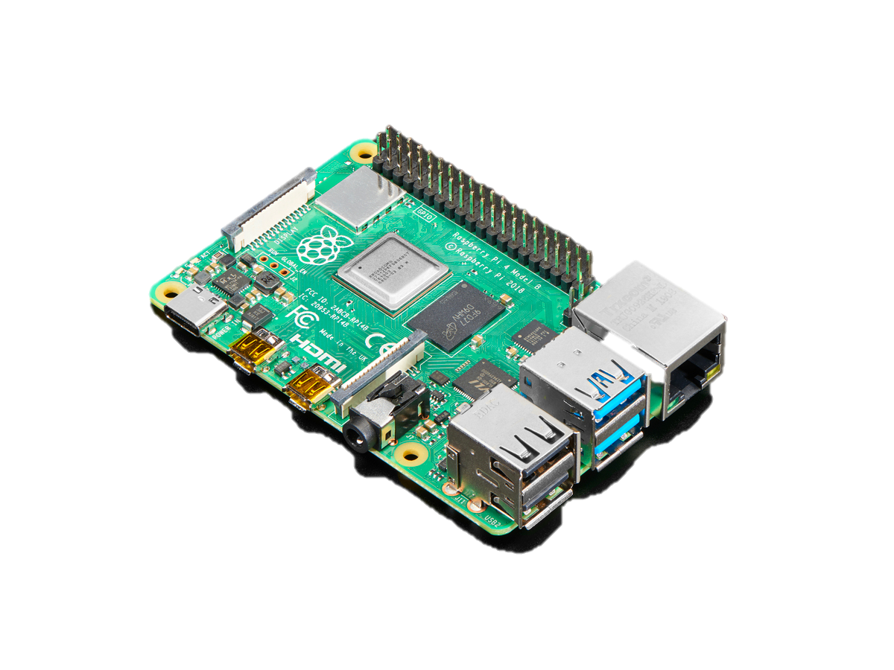
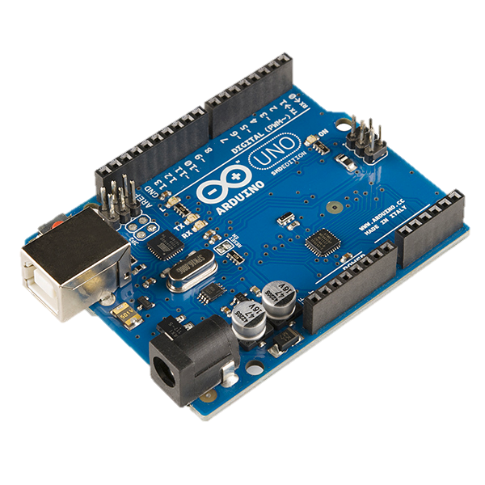
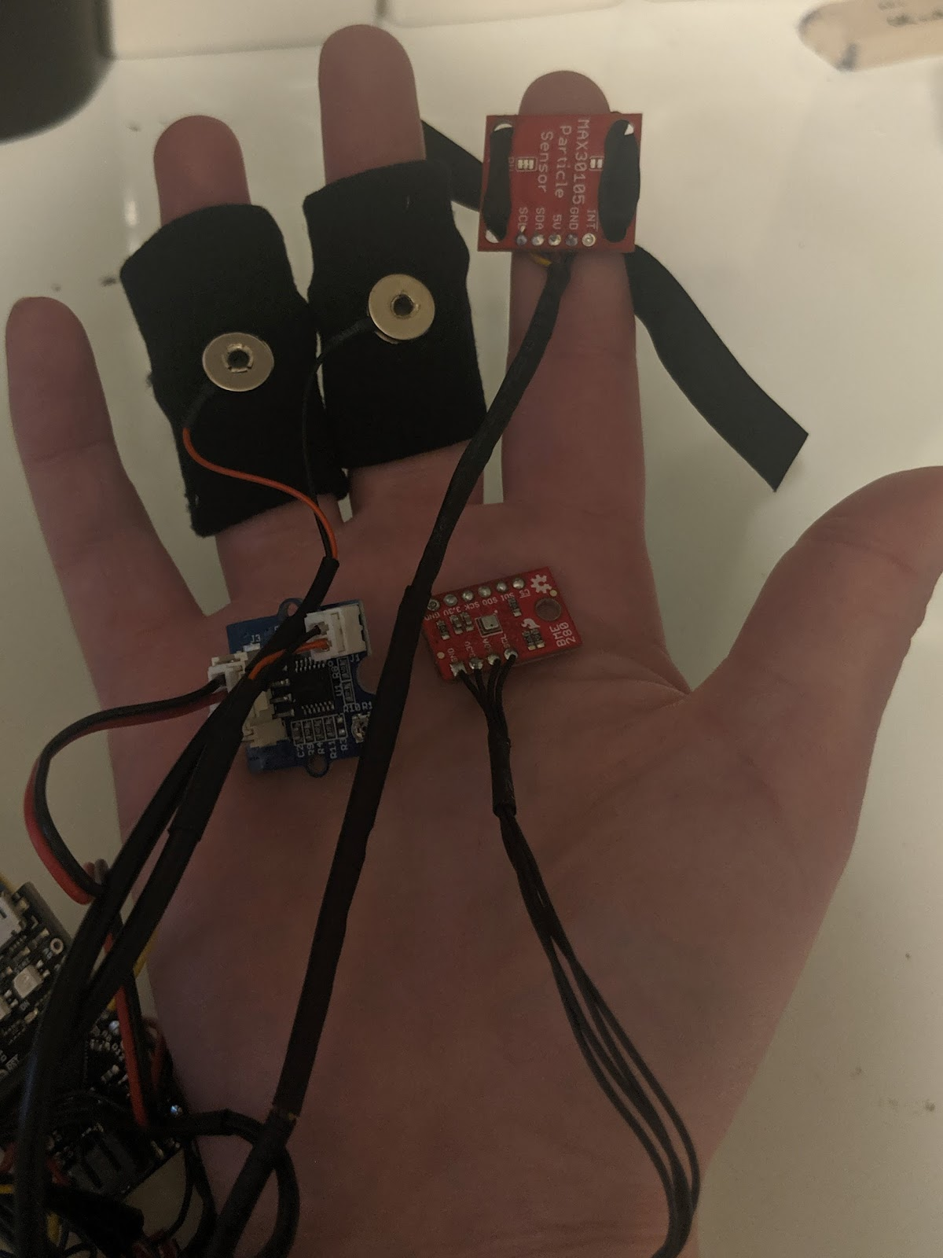
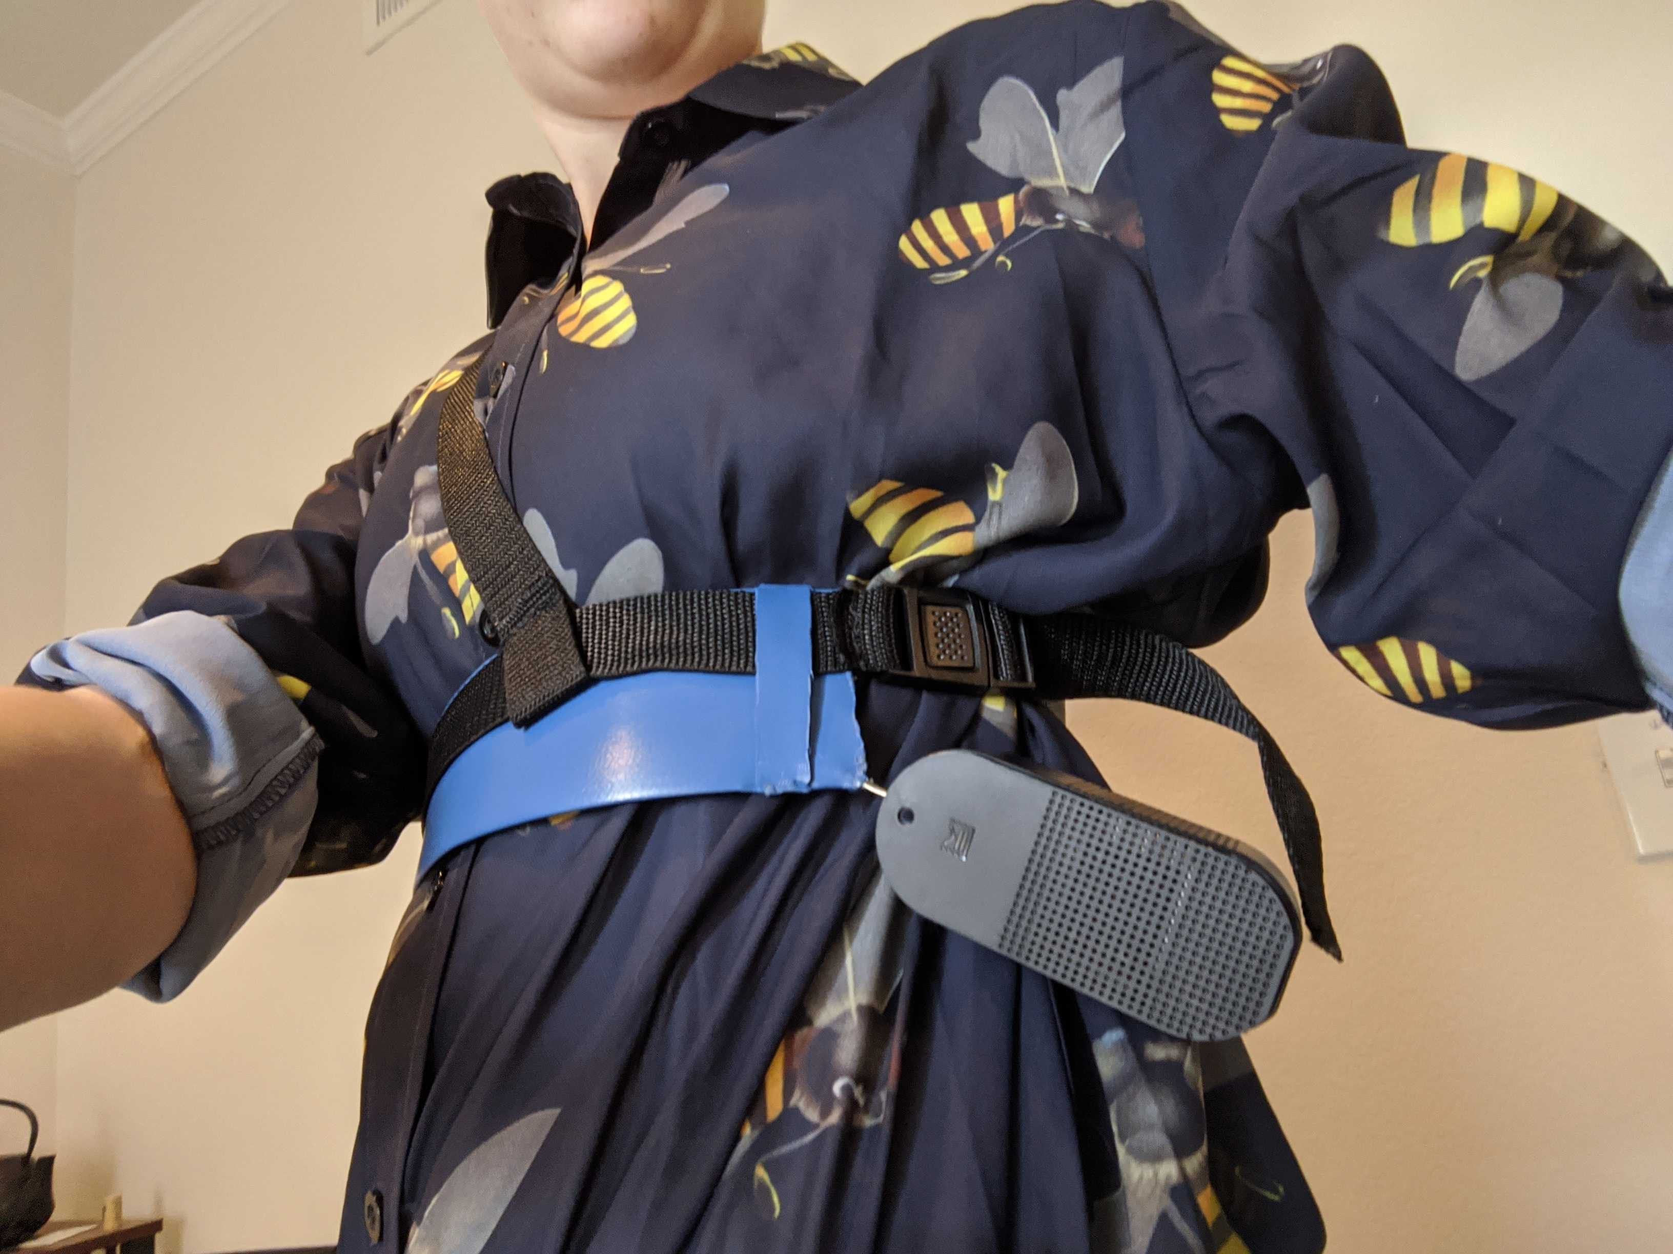
Azure Kinect
Face Recognition
Raspberry Pi 4
Servo Motor
Arduino
Heart Rate
GSR
Blood Oxygen
Respiration
Air Pressure
+ Arduino

